Slide 1
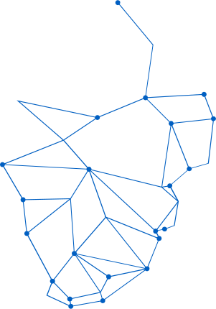

LITTLE STAR MEMORY BOOK
A Database-Driven Web Application for Storing and Displaying Emotional Memories

Slide 2
PROJECT SUMMARY
This is a digital memory storage website where users can write and save love letters.
Instead of keeping memories on paper, users can securely store them in a database.
The system provides:
Letter writing feature
Data saving system
Letter viewing page
Attractive user interface

Slide 3

INTRODUCTION
The main objectives of this project are:
To create a digital memory book
To implement database connectivity using MySQL
To perform CRUD-related operations
To design a responsive and user-friendly interface
To improve practical knowledge of database systems
Background
There is a growing need to preserve emotional memories digitally in an organized, accessible way. Love letters, baby photos, and family moments deserve a secure digital home.
Problem Statement
Traditional methods of preserving memories are scattered across physical locations and digital devices, making them vulnerable to loss, damage, or deterioration over time.

Slide 4
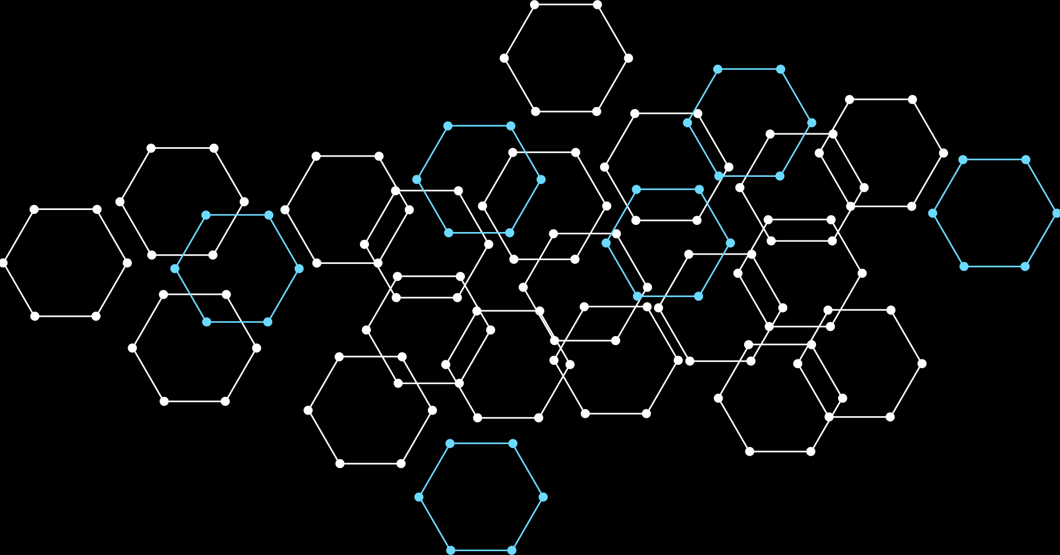



REQUIREMENT ANALYSIS
This project contains both functional and non-functional requirements.
Functional requirements include:
Writing letters
Saving letters
Viewing saved letters
Returning to homepage
Non-functional requirements include:
Security
Responsive design
Fast performance
User-friendly interface

Slide 5
SYSTEM DESIGN OVERVIEW
Architecture
• Presentation: HTML, CSS, JavaScript for user interface
• Application: PHP handles forms, uploads, DB operations
• Database: MySQL stores letters and photos
Database Layer
• MySQL stores all data
• LOVE_LETTERS table
• UPLOAD_PHOTOS table
• Persistent storage
• Data retrieval queries
Workflow
• User opens homepage
• Writes letter or uploads photo
• PHP processes form data
• Data inserted into MySQL database
• User views saved letters/photos

Slide 6

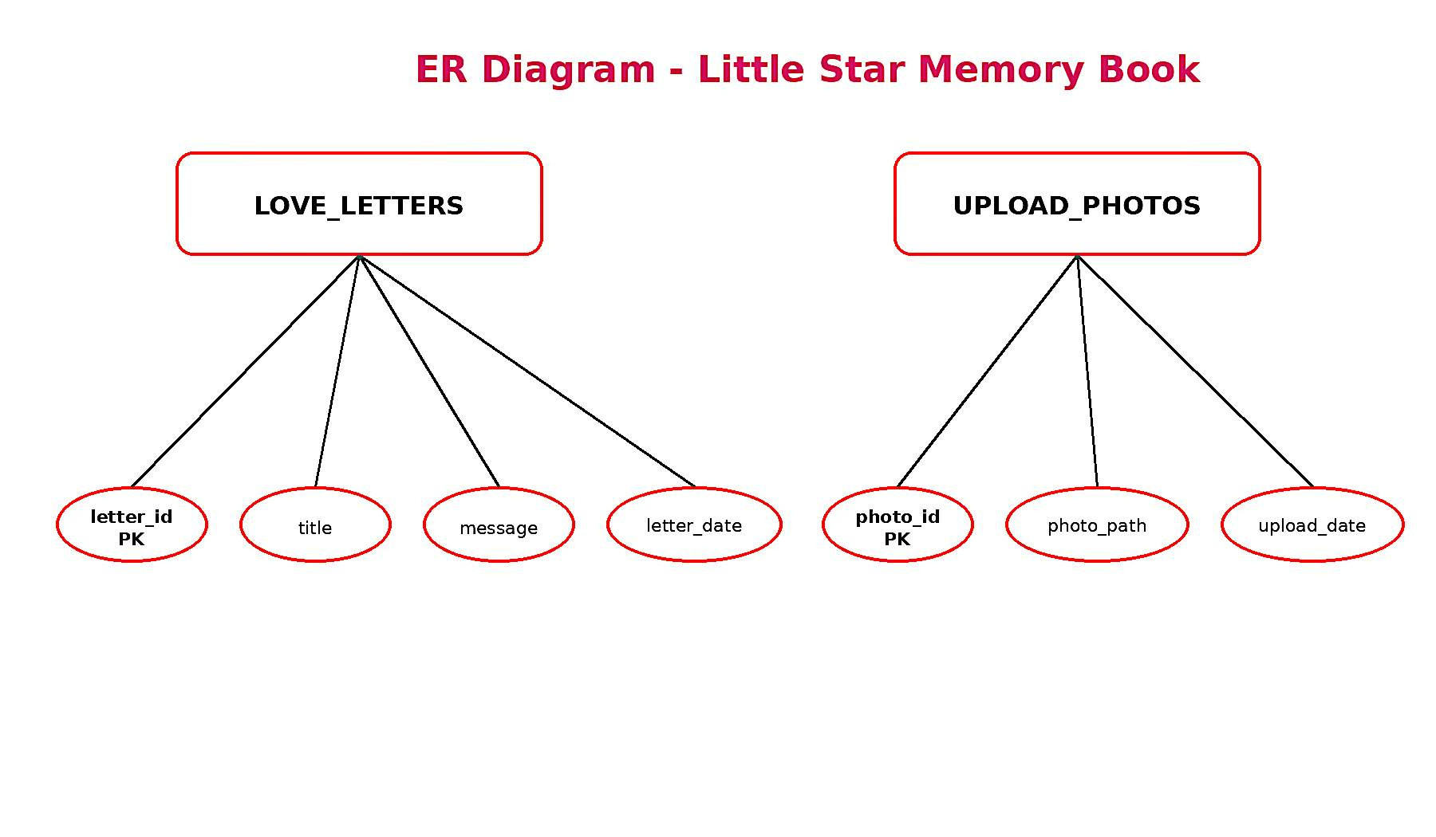
ER DIAGRAM

Slide 7
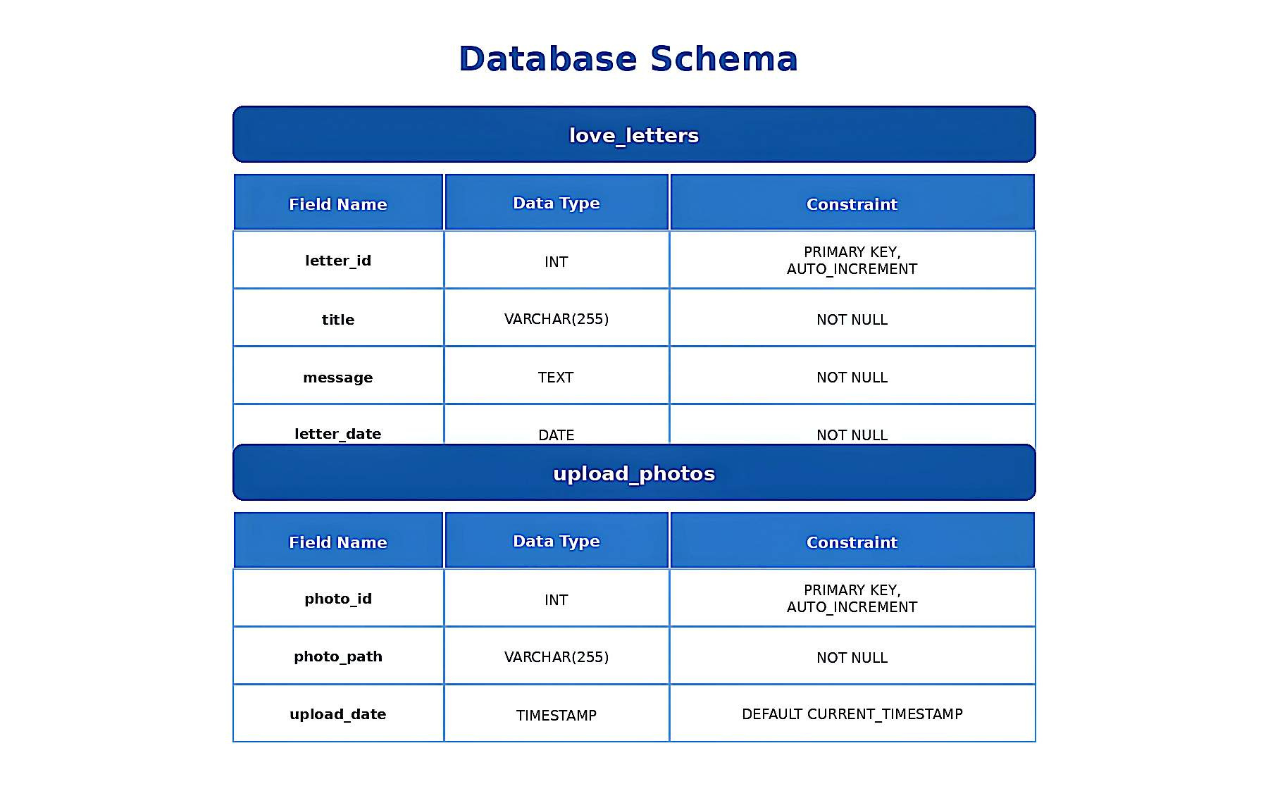
DATABASE SCHEMA

Slide 8
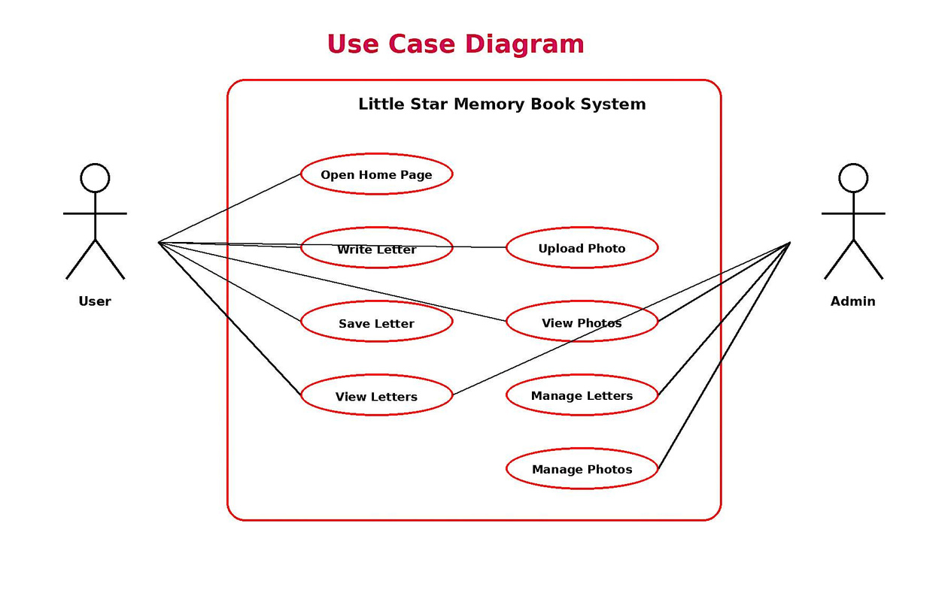
USE CASE DIAGRAM

Slide 9
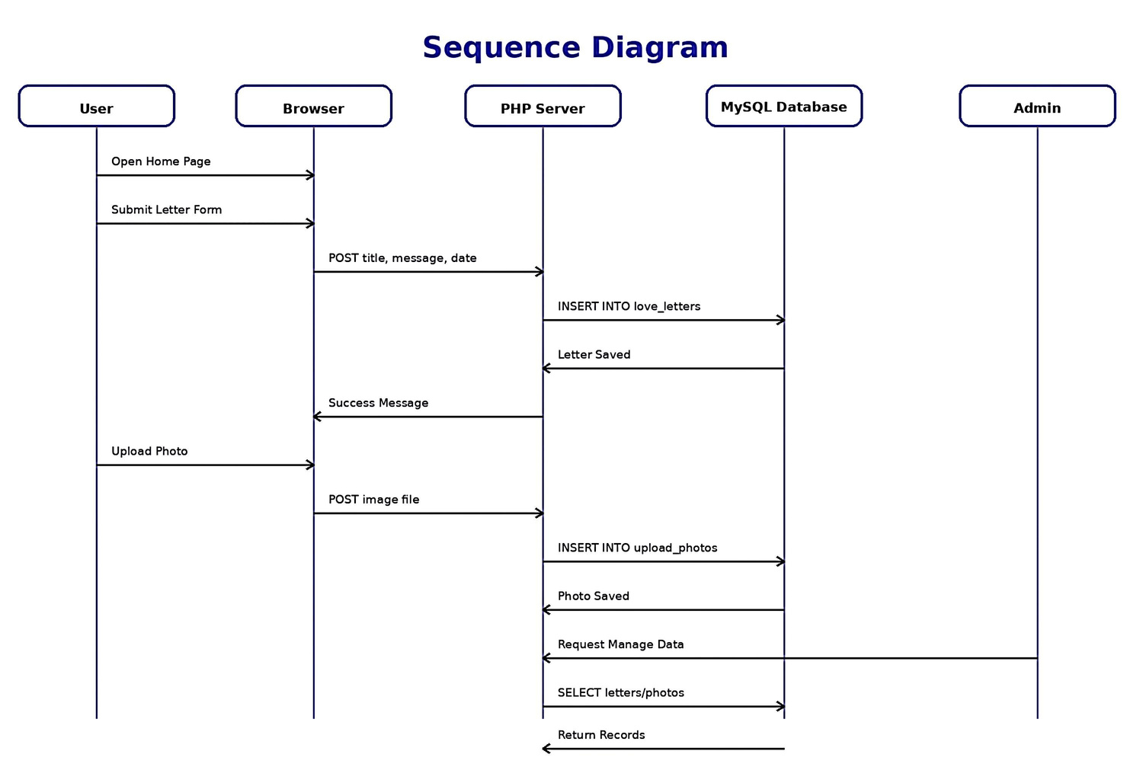
SEQUENCE DIAGRAM

Slide 10



CHALLENGES & LIMITATIONS
Some challenges we faced:
Database connection errors
Form validation issues
Responsive design adjustments

Slide 11

FUTURE IMPROVEMENTS
User login system
Image upload feature
Music customization
Cloud database hosting
Mobile application version

Slide 12
THANK YOU!
Little Star Memory Book demonstrates database-driven web concepts
Questions & Feedback Welcome

